Slide 1


October 2022 Flash
HOLDINGS
COMPUTING
December 2022

Slide 2

Preamble
The following discussion is completely qualified by the legal disclosures on the several pages following this one
Our goal is to share with you some of our strategic thinking and financial analysis we are using to guide the growth of our business
The discussion is in line with our principles of being accountable and transparent with shareholders
We operate in a hyper dynamic economic environment. That’s a fancy way of saying things change quickly. What we are telling you here is based on our estimates and assumptions which are our best guess. We reserve the right to revise our point of view based on new information and changes in the business environment
Despite an uncertain, dynamic environment, we must plan and make operating and investment decisions. This presentation lays some of that out for your review

Slide 3
Legal Disclosure & Disclaimer
This presentation includes forward-looking statements within the meaning of the Private Securities Litigation Reform Act that reflect our current views with respect to, among other things, our operations, business strategy, interpretation of prior development activities, plans to develop and commercialize our products and services, potential market opportunity, financial performance and needs for additional financing. We have used words like "anticipate," "believe," "could," "estimate," "expect," "future," "intend," "may," "plan," "potential," "project," "will," and similar terms and phrases to identify forward-looking statements in this presentation.
The forward-looking statements contained in this presentation are based on management's current expectations and are subject to substantial risks, uncertainty and changes in circumstances. Actual results may differ materially from those expressed by these expectations due to risks and uncertainties, including, among others, those related to our ability to obtain additional capital on favorable terms to us, or at all, the success, timing and cost of ongoing or future operations, the lengthy and unpredictable nature of the project development, and technology process and businesses in which we currently engage or may engage.
These risks and uncertainties include, but may not be limited to, those described in our filings with the SEC. Forward-looking statements speak only as of the date of this presentation, and we undertake no obligation to review or update any forward-looking statement except as may be required by applicable law.

Slide 4
Legal Disclosure & Disclaimer
The material in this presentation has been prepared by Soluna and is general background information about Soluna’s activities, current as at the date of this presentation and is provided for information purposes only. It should be read in conjunction with Soluna’s periodic and continuous disclosure announcements filed with the Securities and Exchange Commission. This presentation provides information in summary form only and is not intended to be complete. Soluna makes no representation or warranty, express or implied, as to the accuracy, completeness, fairness or reliability of any of the information, illustrations, examples, opinions, forecasts, reports, estimates and conclusions contained in this presentation. It is not intended to be relied upon as advice or a recommendation to investors or potential investors and does not take into account the investment objectives, financial situation, taxation situation or needs of any particular investor. Due care and consideration should be undertaken when considering and analyzing Soluna’s future performance and business prospects. THIS PRESENTATION IS NOT INTENDED TO SERVE AS A FORECAST OF ANY SUCH FUTURE PERFORMANCE OR PROSPECTS. An investor must not act on any matter contained in this document but must make its own assessment of Soluna and conduct its own investigations and analysis. Investors should assess their own individual financial circumstances and consider talking to a financial adviser, professional adviser or consultant before making any investment decision. This document does not constitute an offer, invitation, solicitation or recommendation with respect to the purchase or sale of any security in Soluna nor does it constitute financial product advice. This document is not a prospectus, product disclosure statement or other offer document under United States federal or state securities law or under any other law. This document has not been filed, registered or approved by regulatory authorities in any jurisdiction.
Any projection, forecast, estimate or other “forward-looking” statement in this presentation only illustrates hypothetical performance under specified assumptions of events or conditions that have been clearly delineated herein. Such projections, forecasts, estimates or other “forward-looking” statements are not reliable indicators of future performance. Hypothetical or illustrative performance information contained in these materials may not be relied upon as a promise, prediction or projection of future performance and are subject to significant assumptions and limitations. In addition, not all relevant events or conditions may have been considered in developing such assumptions. READERS OF THIS DOCUMENT SHOULD UNDERSTAND THE ASSUMPTIONS AND EVALUATE WHETHER THEY ARE APPROPRIATE FOR THEIR PURPOSES. SOME EVENTS OR CONDITIONS MAY NOT HAVE BEEN CONSIDERED IN SUCH ASSUMPTIONS. ACTUAL EVENTS OR CONDITIONS WILL VARY AND MAY DIFFER MATERIALLY FROM SUCH ASSUMPTIONS. READERS SHOULD UNDERSTAND SUCH ASSUMPTIONS AND EVALUATE WHETHER THEY ARE APPROPRIATE FOR THEIR PURPOSES. This presentation may include figures related to past performance or simulated past performance as well as forecasted or simulated future performance. Soluna disclaims any obligation to update their views of such risks and uncertainties or to publicly announce the results of any revision to the forward-looking statements made herein.

Slide 5
Legal Disclosure & Disclaimer
Use of Projections and Illustrations This presentation contains certain financial forecasts and illustrations. Neither Soluna’s [nor Soluna Holdings] independent auditors have studied, reviewed, compiled or performed any procedures with respect to the projections for the purpose of their inclusion in this presentation. The material in this presentation is for illustrative purposes only and should not be relied upon as being necessarily indicative of future results.
To supplement our consolidated financial statements, which are prepared and presented in accordance with GAAP, we use the following non-GAAP financial measures: non-gaap revenue, cash contribution margin, cash contribution margin excluding tornado, cash contribution margin excl. tornado & shutdown, adjusted cost of cryptocurrency revenue and adjusted EBITDA contribution. The presentation of this financial information is not intended to be considered in isolation or as a substitute for, or superior to, the financial information prepared and presented in accordance with GAAP.
Use of Estimates in Monthly Presentations
Numbers presented BEFORE the release of Form 10-K for fiscal year ended December 31st, 2022, are monthly estimates and subject to change upon final accounting adjustments and entries. These monthly estimates are presented as an illustration of management’s review of key metrics that help in understanding the performance of the Company. Readers are strongly encouraged to review this presentation in connection with the Company’s Quarterly Report on Form 10-Q for the period ended September 30, 2022 and the Company’s Annual Report on Form 10-K for the year ended December 31, 2021.

Slide 6
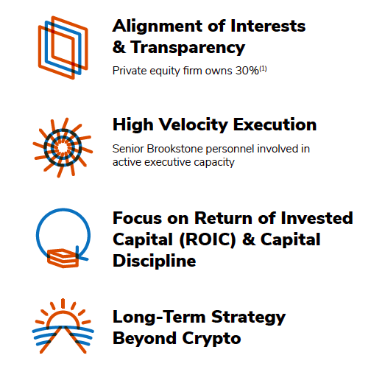
Key Operating Principles
28%⁽¹⁾
(1) Calculated as a percent of total undiluted shares

Slide 7






We buy curtailed energy from renewable power plants and convert it to clean, low-cost global computing.
Excess energy from
renewable sources
Batch-oriented
Computing
like cryptocurrency mining
7

Slide 8




The opportunity beyond crypto is
Batchable
Computing
$10B
Digital currencies
$5B
Pharma research
$40B
Graphics/video processing
$40B
Scientific research

Slide 9


Agenda
In this presentation, we will be covering the following items:
Business Update
Flash October 2022 Results

Slide 10

Business Update

Slide 11


Soluna Status Report
Dorothy Energizing Status
Nearing completion of planning phase of ERCOT approval process providing line of sight to potential energization in early February / early March
50MW doubles Soluna’s operating footprint bringing the organization to scale, opportunity to expand to 100MW at a later date
Common Offering
Existing shareholders supporting continued buildout of Dorothy
$855k initial investment with option for investors to purchase an additional $1.7 million of common equity in two subsequent tranches of $855k
Business Update
October revenues decreased 5.4% despite 9.9% decline in average hashprice from September to October according to Luxor’s hashprice index*, representing 4.5% outperformance to BTC hashprice
Power costs increased 5% in October from September, November costs expected to decrease ~6%, December costs expected to decrease 10%
* Luxor hashprice index ($ / PH / Day) – accounts for changes in Bitcoin price as well as changes in network hashrate

Slide 12
Dorothy Energizing Status
Nearing Completion of Planning Phase
On Track for Energizing in First Quarter of 2023
Planning
Modeling
Operations
  Part of ERCOT approval process focused on grid stability and compliance.
  Typically 90 days or less
  Once Soluna enters this phase we should have clear line of sight to energization.
  Visibility will enable us to procure and plan miner installation.
  Testing and telemetry is conducted
  Execute interconnect
  Install miners
  Begin to ramp facility

Slide 13
Illustrative Dorothy Earnings Potential
XPs
Illustrative Monthly P&L
($ in ‘000s)
*
*
Intended to illustrate cash economics to Soluna, NOT necessarily representative of GAAP accounting representation.
Note: Assumes $17k BTC price, 270 EH / s network hash rate, 90% capacity factor, 95% availability factor, and estimated $35 / kWh average annual power costs (including assumed seasonal demand fees and taxes). Hosting contract based on $60 / kWh fixed rate. Assumes that purchased and hosted machines are 140 Th/s Bitmain XPs.
* Hosting contemplated based on fixed $ / kWh basis to conform to potential Bitmain hosting construct, if XPs were hosted with pass-through construct inflows would expected to be higher.

Slide 14
Illustrative Dorothy Earnings Potential
S19s
Illustrative Monthly P&L
($ in ‘000s)
Intended to illustrate cash economics to Soluna, NOT representative of GAAP accounting representation.
Note: Assumes $17k BTC price, 270 EH / s network hash rate, 90% capacity factor, 95% availability factor, and estimated $35 / kWh average annual power costs (including assumed seasonal demand fees and taxes). Hosting contract includes power cost pass-through, $146k fixed fee per 10 MW, and 15% profit share. Assumes that purchased and hosted machines are 100 Th/s S19j Pros. Cash inflows not referred to as revenue due to pending GAAP treatment of power cost pass-through for hosting contracts.

Slide 15
Operational Efficiencies - Soluna outperforms
hashprice declines
Percent Decline
4.5% Relative Outperformance
*
(Non-GAAP)
* Luxor hashprice index ($ / PH / Day) – accounts for changes in Bitcoin price as well as changes in network hashrate

Slide 16

Power Cost Update
Updates on Sophie and Marie Power Costs
FUEL COST ADJUSTMENT (“FCA”) SINCE JUNE
% Month-over-Month Change
October FCA of 2.992 cents per kWh represents a 33% decline from August FCA
Based on discussions with industry sources November FCA anticipated to decrease 6% from October levels
  November FCA declined ~15% from previously expected FCA of $3.282
Based on discussions with industry sources December FCA anticipated to decrease 10% from November levels bringing power costs below June levels
43%
16%
(37%)
5%
(6%)
*
(10%)
* Represents our understanding of expected FCA in December based on discussions with industry sources.

Slide 17
Illustrative Cash Contribution Impact from
Potential Power Cost Declines in Nov. / Dec.
Potential power cost declines in November and December could represent $50 - $150 thousand in incremental Cash Contribution Margins*
* Represents our understanding of expected FCA declines in November and December based on discussions with industry sources.

Slide 18

Facility Results Review
  We will review each facility
  Then look at the consolidated results

Slide 19
September Business Summary
Flat BTC Production Despite Volatile Market
BTC equivalent mined per day only decreased 1% despite average hashprice* declining 10% from September to October
Peak hashrate remained around 1 EH/s
Cash Contribution Margins Expected to Improve in November and December
19% Consolidated cash contribution margins remain above July and August lows despite low BTC environment and energy costs that increased from September to October
Power costs expected to decline in November and December based on conversations with industry sources which should improve margins from October levels
Hosting Agreement at Marie Remains Significantly More Profitable
Hosting margins in October remained at 35% compared to (15%) in August
* Luxor data - https://www.blockchain.com/explorer/charts/hash-rate

Slide 20
Path to 2.5 EH/s Scale
Subject to Project Finance Process + Ercot

Slide 21

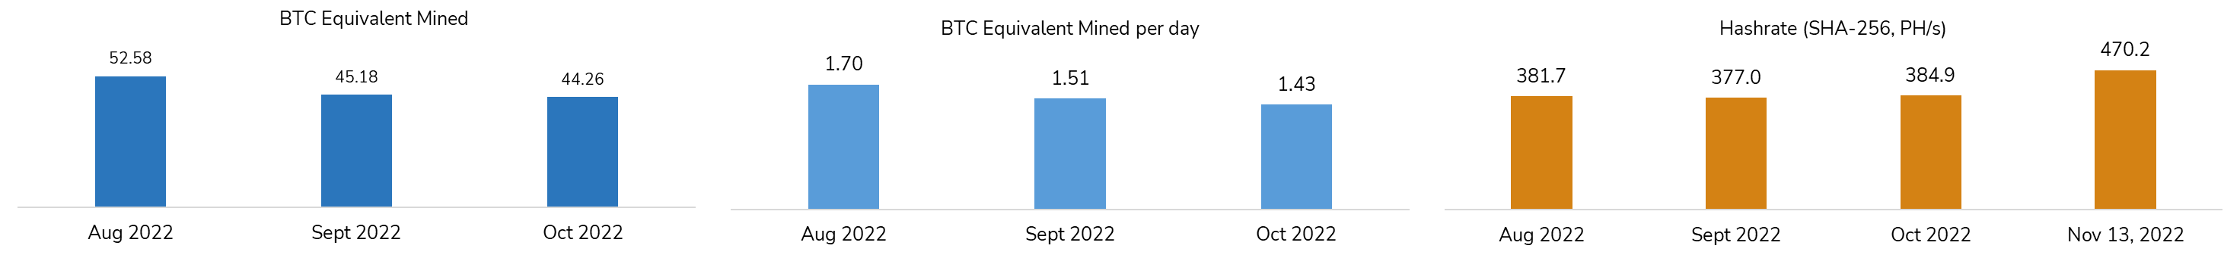
Sophie
Average September PH/s increased by 2% to 384.9 PH/s versus September PH/s of 377.0
Adjusted Cash Contribution Margin (Non-GAAP) in October was $241 thousand versus $324 thousand in September
  The 26% decrease in Cash Contribution Margin was due to a 3% decline in revenue, a 10% increase in power costs, and a 10% increase in overhead costs excluding non-cash charges
Site continues to perform despite low BTC price environment
Power costs expected to decline in November alleviating margin pressure
2%
22%
**
(14%)
(2%)
(11%)
(5%)
(1%)
(31 days)
(30 days)
(31 days)
Note: July - September 2022 hashrate represents monthly average.
* Luxor data - https://www.blockchain.com/explorer/charts/hash-rate
** Daily average hashrate.

Slide 22
Sophie: Non-GAAP Historical Financials
For more information on these non-GAAP financial measures, please see the section captioned “Reconciliation of non-GAAP results of operations to the nearest comparable GAAP measures”. To supplement our consolidated financial statements, which are prepared and presented in accordance with GAAP, we use the following non-GAAP financial measures: non-gaap revenue, contribution margin, cash contribution margin, adjusted cost of cryptocurrency revenue and adjusted EBITDA contribution. The presentation of this financial information is not intended to be considered in isolation or as a substitute for, or superior to, the financial information prepared and presented in accordance with GAAP.

Slide 23

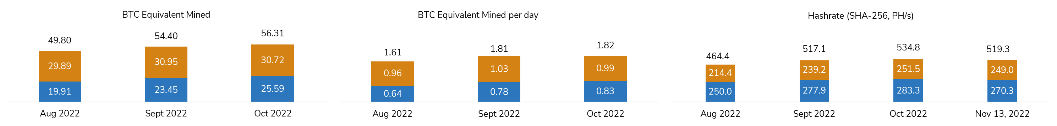
Marie
Average hashrate in October increased to 534.8, compared to 517.1 in September
  The 3% increase was in part due to reduced TVA curtailments and cooler temperatures improving hash rate conditions
  Average prop hashrate remained above 250 PH/s
Cash Contribution Margin in October was $140 thousand, compared to $202 thousand in September
  Decrease was largely due to higher power costs and 4% decline in revenue as a result of hashprice declines
  New hosting contract continues to demonstrate significantly improved profitability from July and August lows
9%
4%
13%
0%
11%
3%
(3%)
*
*
**
(31 days)
(30 days)
(31 days)
Note: July - September 2022 hashrate represents monthly average.
* Hosting contract as of September 1, 2022 passes through power costs to the hosting customer. To better illustrate September results relative to prior months hosting BTC equivalent mined includes power costs that are passed through. GAAP reporting will require that we present revenue on a net basis since the power costs will be passed through.
** Daily average hashrate.

Slide 24

Marie: Non-GAAP Historical Financials^{(A)}
Excludes ~$276k and ~$338k of power costs which are passed directly to hosting customer in September and October, respectively
(A) Marie excludes pass-through revenue and expenses from Legacy Hosting customers. Electricity/Direct Costs reduced by Marie “Prepaid Lease Cost” August 2021 onward.. For details on legacy hosting, see appendix. For more information on these non-GAAP financial measures, please see the section captioned “Reconciliation of non-GAAP results of operations to the nearest comparable GAAP measures”. To supplement our consolidated financial statements, which are prepared and presented in accordance with GAAP, we use the following non-GAAP financial measures: non-gaap revenue, contribution margin, cash contribution margin, adjusted cost of cryptocurrency revenue and adjusted EBITDA contribution. The presentation of this financial information is not intended to be considered in isolation or as a substitute for, or superior to, the financial information prepared and presented in accordance with GAAP.

Slide 25
Marie: Operating Metrics^{(A)}
*
*
*
*
* Hosting contract as of September 1, 2022 passes through power costs to the hosting customer. To better illustrate September and October results relative to prior months hosting BTC equivalent mined includes power costs that are passed through. GAAP reporting will require that we present revenue on a net basis since the power costs will be passed through.
(A) Marie excludes pass-through revenue and expenses from Legacy Hosting customers. Electricity/Direct Costs reduced by Marie “Prepaid Lease Cost” August 2021 onward. For details on legacy hosting, see appendix. For more information on these non-GAAP financial measures, please see the section captioned “Reconciliation of non-GAAP results of operations to the nearest comparable GAAP measures”. To supplement our consolidated financial statements, which are prepared and presented in accordance with GAAP, we use the following non-GAAP financial measures: non-gaap revenue, contribution margin, cash contribution margin, adjusted cost of cryptocurrency revenue and adjusted EBITDA contribution. The presentation of this financial information is not intended to be considered in isolation or as a substitute for, or superior to, the financial information prepared and presented in accordance with GAAP.

Slide 26
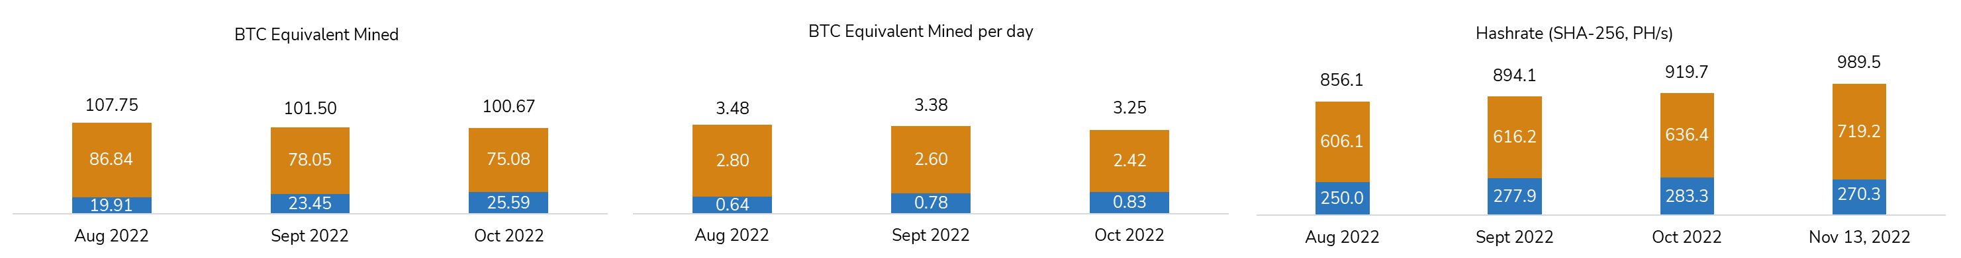
Site Consolidation
Average BTC mined declined by 1% versus September
Average hashrate set a new monthly record of 919.7 PH/s, previous high of 896.62 achieved in May 2022
  Average hashrate increased 3% from September
Cash Contribution margins remained healthy but declined from September as a result of increased power prices in September
Power costs expected to decline in November and December
4%
3%
8%
*
(6%)
(1%)
(3%)
(4%)
**
**
***
(31 days)
(30 days)
(31 days)
Note: July - September 2022 hashrate represents monthly average.
* Increased by one bitcoin as a result of forced shutdown.
** Hosting contract as of September 1, 2022 passes through power costs to the hosting customer. To better illustrate September results relative to prior months hosting BTC equivalent mined includes power costs that are passed through. GAAP reporting will require that we present revenue on a net basis since the power costs will be passed through.
*** Daily average hashrate.

Slide 27
Consolidated Soluna Computing Non-GAAP Historical Financials^{(A)}
Excludes ~$276k and ~$338k of power costs which are passed directly to hosting customer in September and October, respectively
(A) Marie excludes pass-through revenue and expenses from Legacy Hosting customers. Electricity/Direct Costs reduced by Marie “Prepaid Lease Cost” August 2021 onward. For details on legacy hosting, see appendix. For more information on these non-GAAP financial measures, please see the section captioned “Reconciliation of non-GAAP results of operations to the nearest comparable GAAP measures”. To supplement our consolidated financial statements, which are prepared and presented in accordance with GAAP, we use the following non-GAAP financial measures: non-gaap revenue, contribution margin, cash contribution margin, adjusted cost of cryptocurrency revenue and adjusted EBITDA contribution. The presentation of this financial information is not intended to be considered in isolation or as a substitute for, or superior to, the financial information prepared and presented in accordance with GAAP.
Notes:
Dorothy - $20k of Dorothy Overhead is included in this summary page

Slide 28
Consolidated Soluna Computing Operating Metrics^{(A)}
*
*
* Hosting contract as of September 1, 2022 passes through power costs to the hosting customer. To better illustrate September and October results relative to prior months hosting BTC equivalent mined includes power costs that are passed through. GAAP reporting will require that we present revenue on a net basis since the power costs will be passed through.
(A) Marie excludes pass-through revenue and expenses from Legacy Hosting customers. Electricity/Direct Costs reduced by Marie “Prepaid Lease Cost” August 2021 onward. For details on legacy hosting, see appendix. For more information on these non-GAAP financial measures, please see the section captioned “Reconciliation of non-GAAP results of operations to the nearest comparable GAAP measures”. To supplement our consolidated financial statements, which are prepared and presented in accordance with GAAP, we use the following non-GAAP financial measures: non-gaap revenue, contribution margin, cash contribution margin, adjusted cost of cryptocurrency revenue and adjusted EBITDA contribution. The presentation of this financial information is not intended to be considered in isolation or as a substitute for, or superior to, the financial information prepared and presented in accordance with GAAP.

Slide 29
Reconciliation of non-GAAP results of operations to the nearest comparable GAAP measures

Slide 30
2022 October YTD - Reconciliation Of Non-GAAP Results

Slide 31
2022 October YTD - Reconciliation Of Non-GAAP Results

Slide 32
2022 October YTD - Reconciliation Of Non-GAAP Results

Slide 33
2022 Q3 - Reconciliation Of Non-GAAP Results

Slide 34
2022 Q3 - Reconciliation Of Non-GAAP Results

Slide 35
2022 Q3 - Reconciliation Of Non-GAAP Results

Slide 36
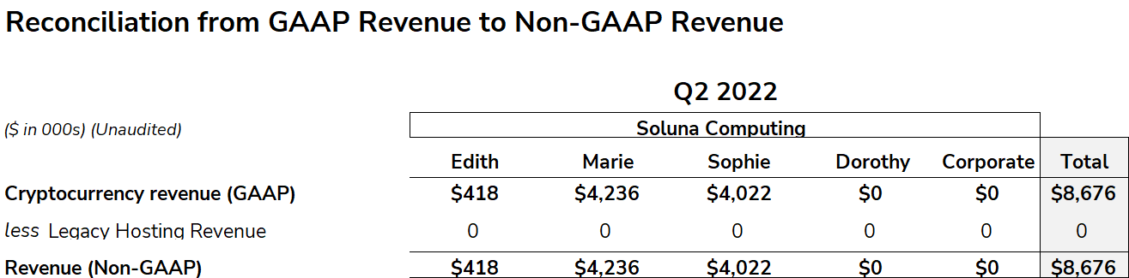
2022 Q2 - Reconciliation Of Non-GAAP Results

Slide 37
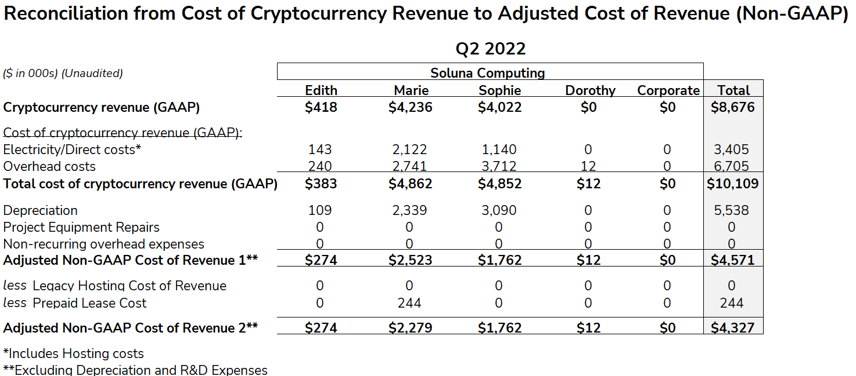
2022 Q2 - Reconciliation Of Non-GAAP Results

Slide 38
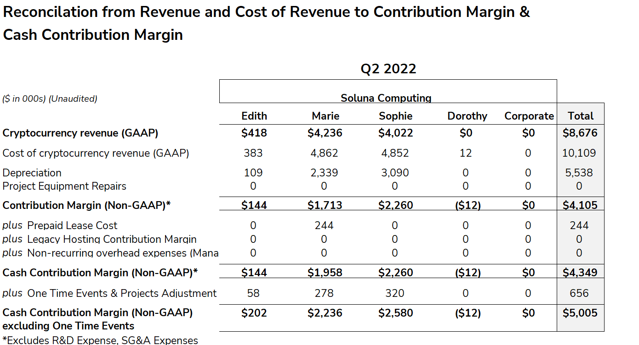
2022 Q2 - Reconciliation Of Non-GAAP Results

Slide 39
2022 Q1 - Reconciliation Of Non-GAAP Results

Slide 40
2022 Q1 - Reconciliation Of Non-GAAP Results

Slide 41
2022 Q1 - Reconciliation Of Non-GAAP Results

Slide 42
2021 FY - Reconciliation Of Non-GAAP Results

Slide 43
2021 FY - Reconciliation Of Non-GAAP Results

Slide 44
2021 FY - Reconciliation Of Non-GAAP Results

Slide 45
2021 Q4 - Reconciliation Of Non-GAAP Results

Slide 46
2021 Q4 - Reconciliation Of Non-GAAP Results

Slide 47
2021 Q4 - Reconciliation Of Non-GAAP Results

Slide 48
2021 Q3 - Reconciliation Of Non-GAAP Results

Slide 49
2021 Q3 - Reconciliation Of Non-GAAP Results

Slide 50
2021 Q3 - Reconciliation Of Non-GAAP Results

Slide 51
2021 Q2 - Reconciliation Of Non-GAAP Results

Slide 52
2021 Q2 - Reconciliation Of Non-GAAP Results

Slide 53
2021 Q1 - Reconciliation Of Non-GAAP Results

Slide 54
2021 Q1 - Reconciliation Of Non-GAAP Results

Slide 55
The future of
renewable energy
is computing.

Slide 56
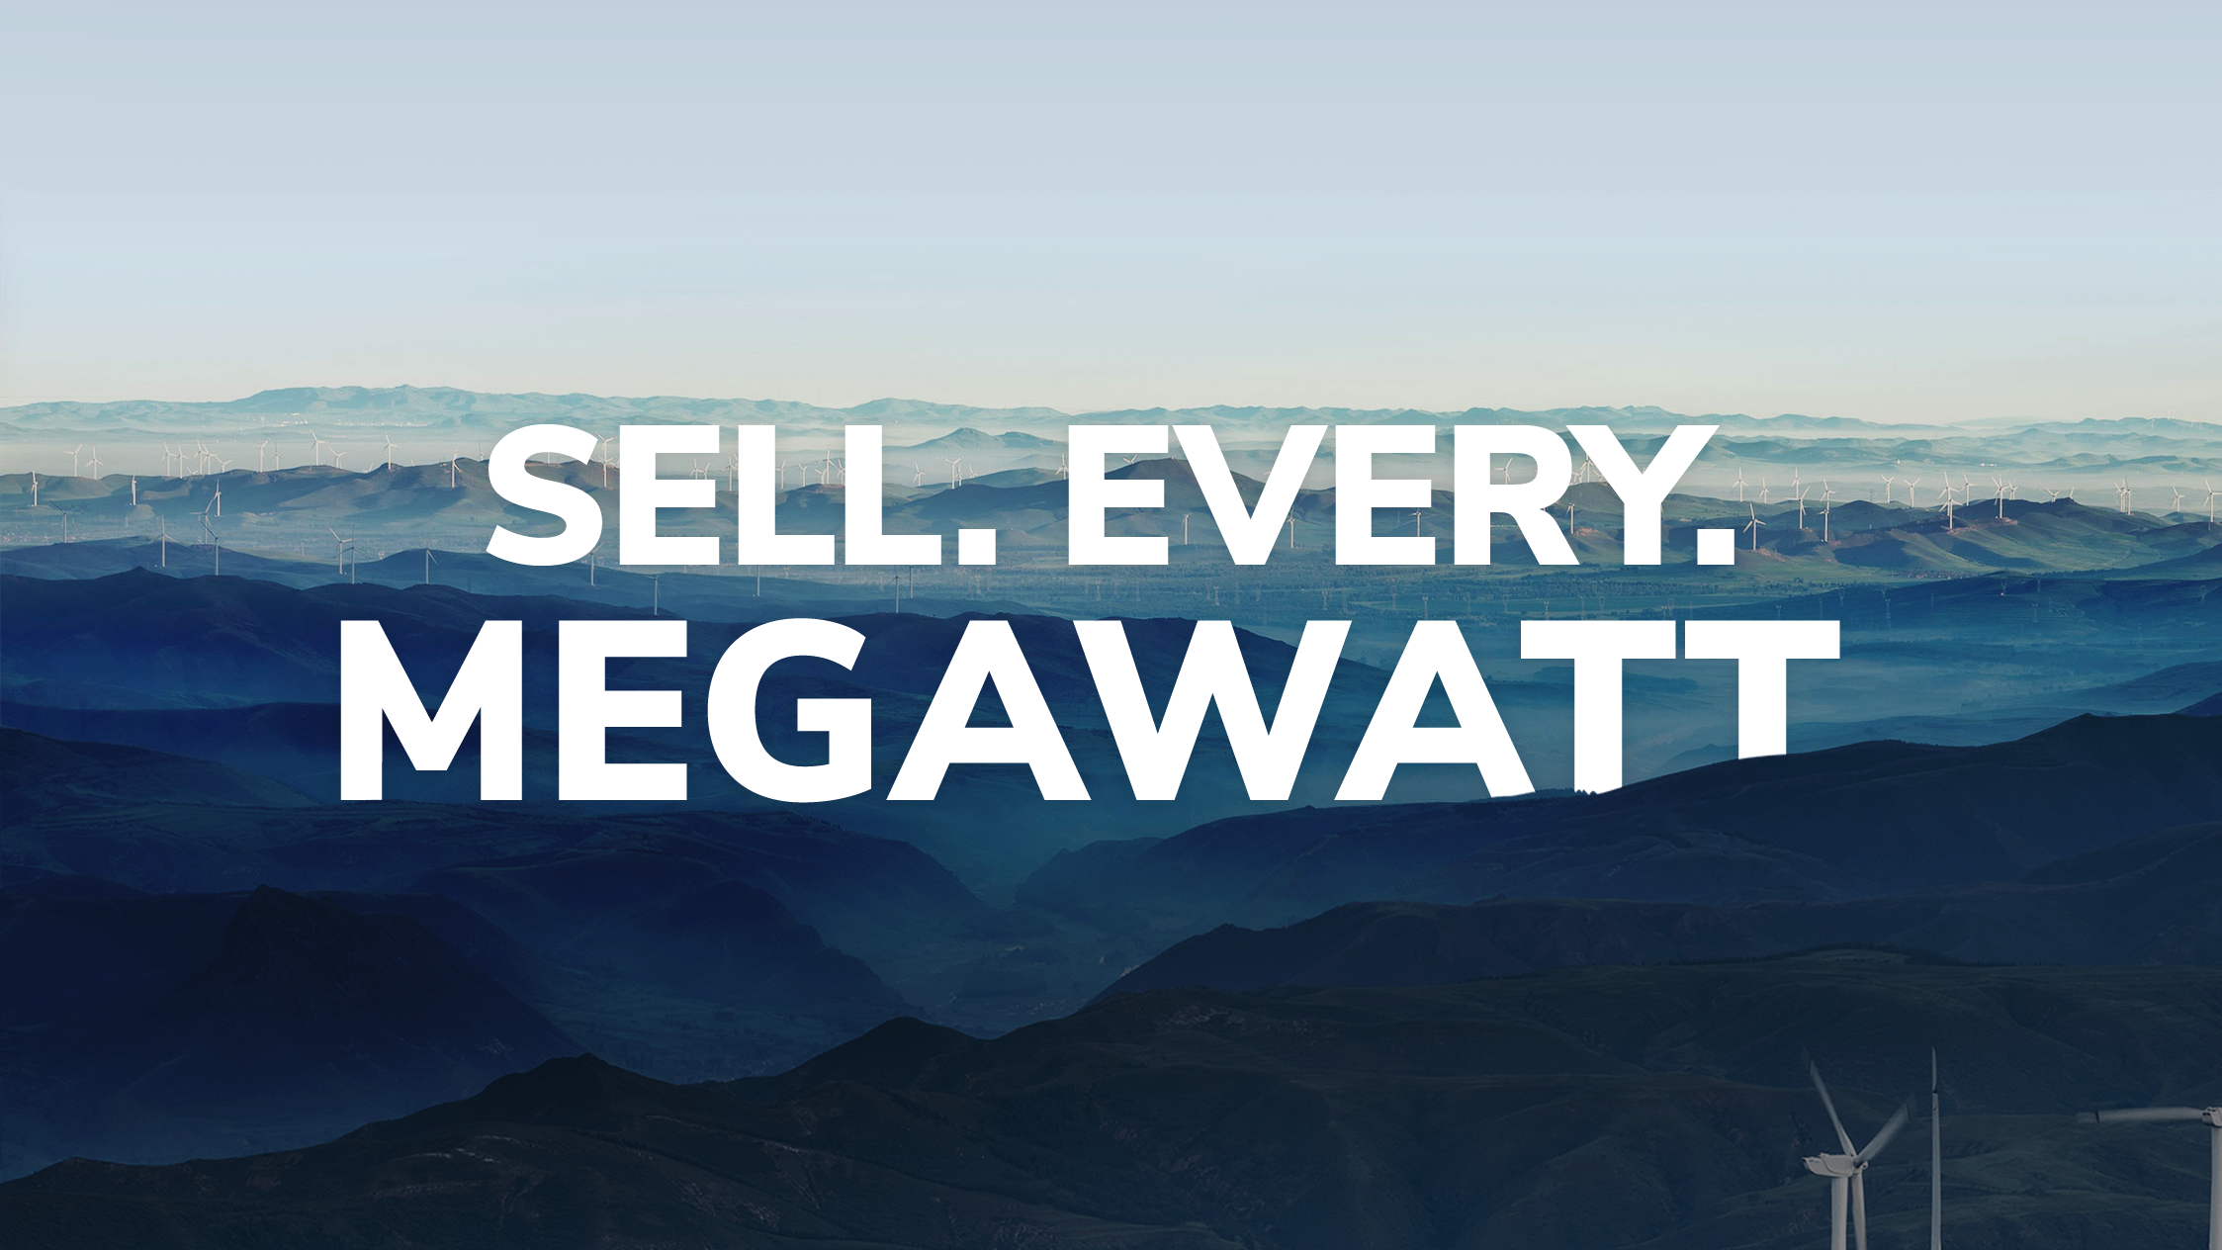

Learn more at solunacomputing.com

